Slide 1
Market Structures
Perfect Competition
Monopoly
Monopolistic Competition
Duopoly
Oligopoly

Slide 2
Topic 8: Analysis of Perfectly Competitive Markets

Slide 3
CHAPTER OUTLINE
Supply Behavior of the Competitive Firm
Behavior of a Competitive Firm
Profit Maximization
Perfect Competition
Efficiency of Competitive Markets

Slide 4
Features of Perfectly Competitive Market
Large Number of Buyers and Sellers: A single buyer/seller cannot influence the price because (s)he has a negligible share in total market demand/ supply and hence, a price taker and not price maker.
Product is homogenous. Hence, no single producer can raise the price as quantity demanded from him will fall to zero. Demand curve is parallel to X-axis (Q,P plane). Demand curve P = a. At a given price, a seller can sell any amount of good in the perfect market. Hence, MR = AR.

Slide 5
Features of Perfectly Competitive Market
Free entry and exit of the firms. No producer can earn super-normal profits/sub-normal profits in the long-run.
Industry demand curve is downward sloping but the demand curve faced by an individual firm is horizontal.
Note: When a firm earns normal profits, i.e., its price covers all costs (including the managerial costs).
Super-normal profits(AR-AC>0).
Sub-normal proftis (AR-AC<0).
Normal Proftits (AR-AC=0:AR=AC)

Slide 6
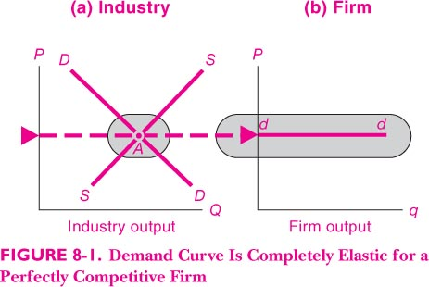
Demand Curve is perfectly Elastic for a perfectly competitive firm

Slide 7
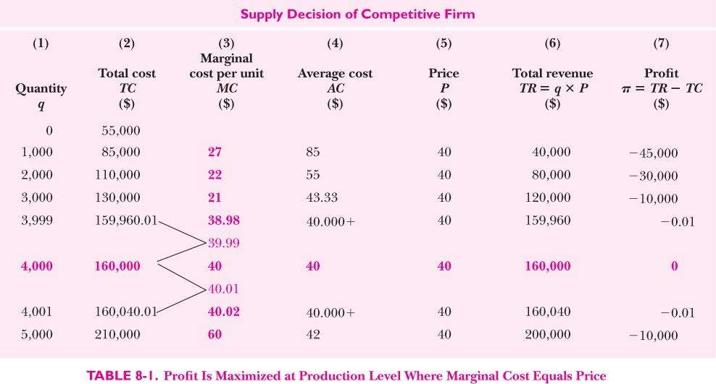
Profit max when MR = MC = P

Slide 8
Profit maximization of a firm
TR (Q)-TC (Q) = Π ….(1)
Π max when dTR/dQ - dTC/dQ' = 0
i.e., MR-MC = 0; MR = MC ……(2)
In Perfect competition AR=P=MR …… (3)
Combining (2) and (3) we get
Π max output (supply) will be when P = MC
d²TR/dQ² - d²TC/dQ² <0 or d²TR/dQ² < d²TC/dQ² i.e., slope of MR curve should be less than the slope of MC curve. Since the slope of MR curve is ‘0’, the slope of should be positive, i.e., marginal cost curve should be rising. Declining marginal cost incompatible with perfect competition.

Slide 9
Short-run vs Long-run Equi of a Competitive Firm
In the short run, a competitive firm may earn super-normal Π. If this is so, other firms will enter the industry and increase supply and bring down the price. Opposite will take place if the firms are making losses or earning sub-normal profits. In this case, firms will exit. Hence, the long-run equilibrium in a perfectly competitive industry will be when Min AC=AR=MR=MC, i.e., at the break-even point.

Slide 10
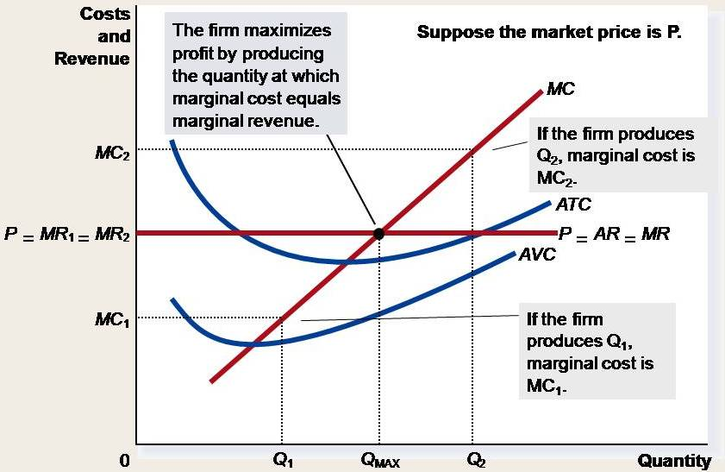
Profit maximization of a perfectly Competitive firm in the short run

Slide 11
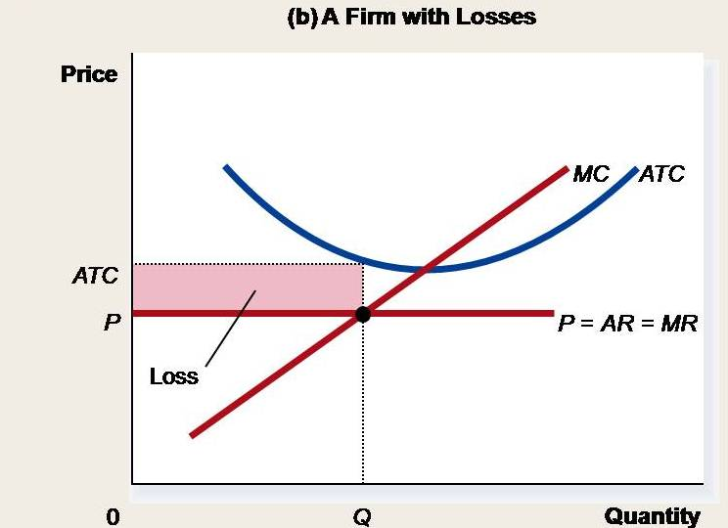
Profit/losses as the Area between Price and Average Total Cost

Slide 12
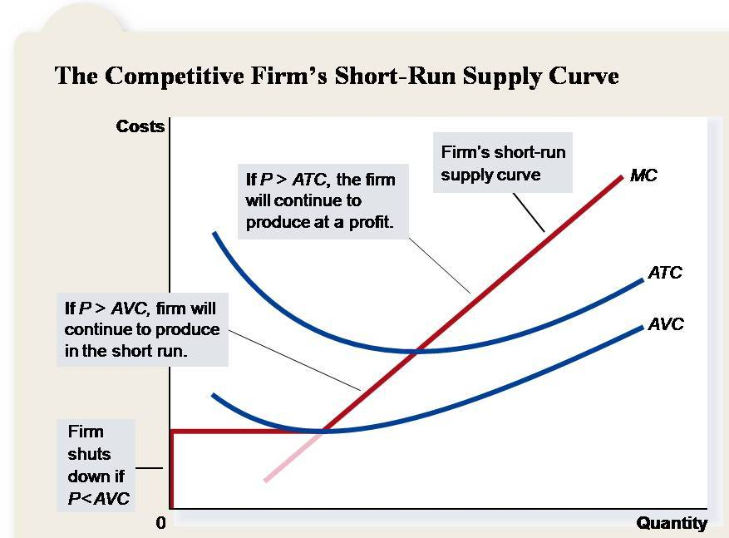

Slide 13
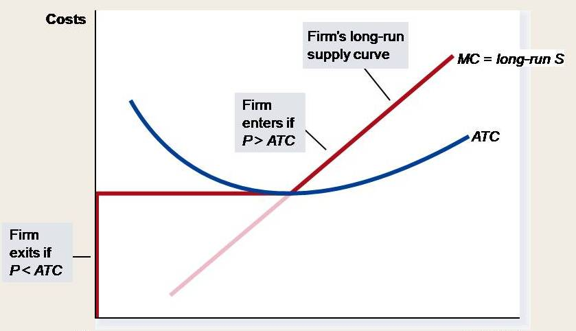
Firm’s long run supply curve

Slide 14
Entry and exit of firms from industry
If the existing firms are making supernormal profits, new firms will enter the market, leading to increase in output and reduction in price until the supernormal profits are wiped off.
If some of the existing firms are making losses profits, these firms will leave the market (in the short run shut down if P < AVC and in the long run if P < AC) leading to decrease in output and increase in price until the normal profits are restored in the industry.

Slide 15
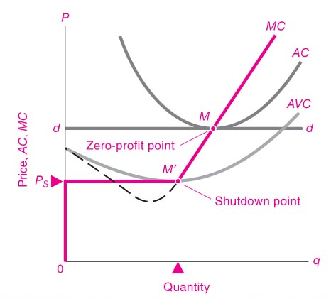
Long Run Equi of a competitive firm: Zero (normal) Profits and Shut down point
M’ Shut-down point
A shutdown refers to a short-run decision not to produce anything during a specific period of time because of current market conditions.
Exit refers to a long-run decision to leave the market.

Slide 16
Why Do Competitive Firms Stay in Business If They Make Zero Profit?
Profit equals total revenue minus total cost.
Total cost includes all the opportunity costs of the firm.
In the zero-profit equilibrium, the firm’s revenue compensates the owners for the time and money they expend to keep the business going.

Slide 17
Shut down point
Shut-down condition, When AVC=P
When market price is just sufficient to cover the average variable cost and no more. In this case the firm loses the fixed costs. The firm will not shut-down in the short-run if it is able to recover at least all its variable costs.

Slide 18
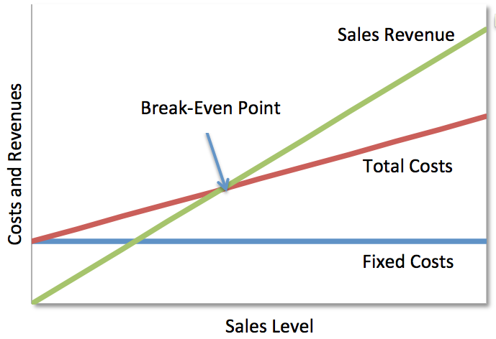
Break-even point (BEP): when TR = TC (P=AR=AC), before BEP, TR< TC (P < AC), After BEP TR > TC (P > AC)

Slide 19
Efficiency
Producers operate on the lowest point of average cost curve. The price is lowest as compared to other forms of market structures.

